Slide 1
HEALTH INFORMATION SYSTEM TEDDY AKUMU 26TH April 2025 CEMA SOFTWARE ENGINEERING INTERN TASK

Slide 2
PROJECT OVERVIEW
A simple web-based application to manage clients and health programs.
Allows doctors/ users to:
Create Health Programs
Register new clients in the system
Enroll Clients in one or more programs
Search for clients in a list of registered clients
View profile of clients and programs they are enrolled in
Supports external systems retrieving client via an API

Slide 3
PROBLEM STATEMENT
Healthcare providers need an efficient system to manage client health data
Manual processes are slow and error-prone
Need to integrate with other systems easily via APIs

Slide 4
APPROACH
Build a simple and scalable web application
Store client and program data efficiently
Provide a clean user interface for doctors
Develop a RESTful API to expose client data

Slide 5
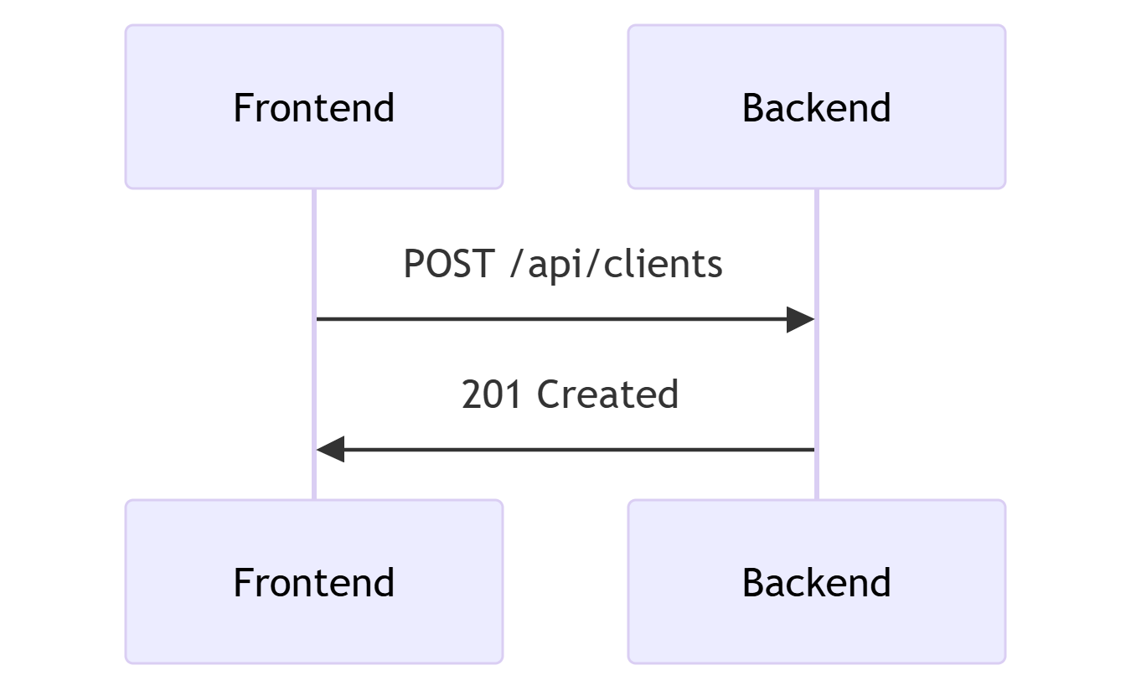
SYSTEM DESIGN
Components
Frontend: Responsive web interface; Html, css, Javascript
Backend: REST API endpoints, Python(Flask)
Data: JSON-based structure
Communication: Fetch API for calling backend
Storage: LocalStorage for client simulation
Data Flow

Slide 6
KEY FEATURES
Create Health Programs – e.g., TB, HIV
Register New Clients – add demographic information
Enroll Clients in Programs – one or multiple
Search Clients – list, filter, view
View Client Profile – including all enrollments
API Endpoint – expose client data externally

Slide 7
API EXPOSURE
RESTful API built to expose client information
Supports external retrieval of:
Name, Age, Gender
Programs and time Enrolled
Example Endpoint:
GET /clients/{id}/profile

Slide 8
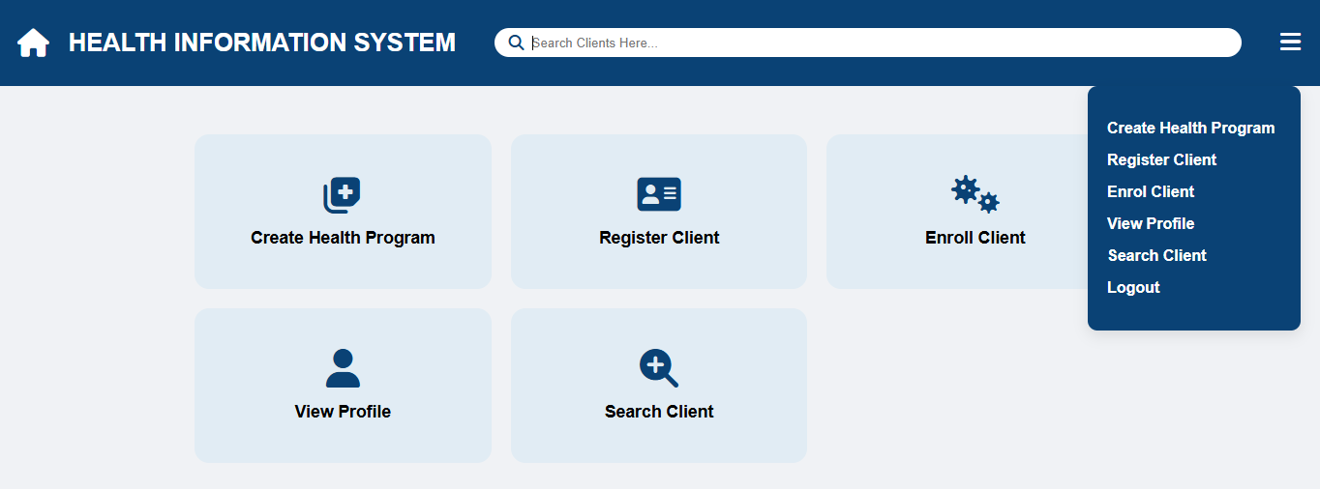
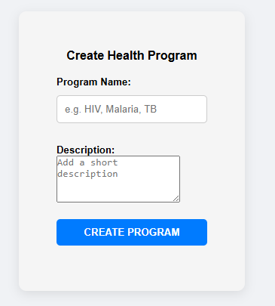
DEMO SCREENSHOTS
Dashboard
program creation

Slide 9
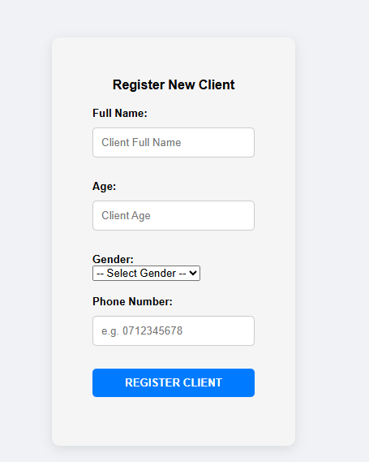
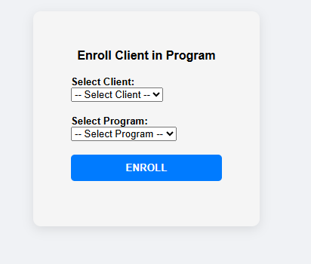
DEMO SCREENSHOTS
Client Registration
Enrollment page

Slide 10
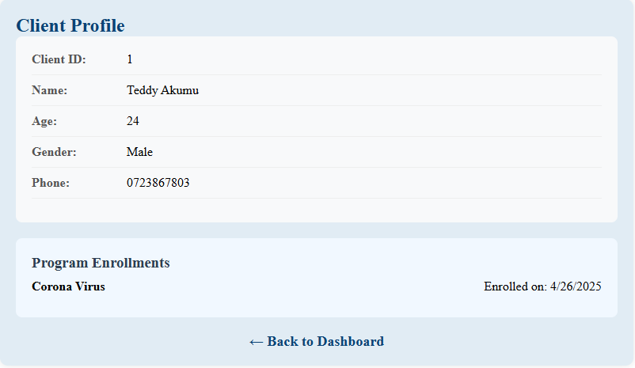
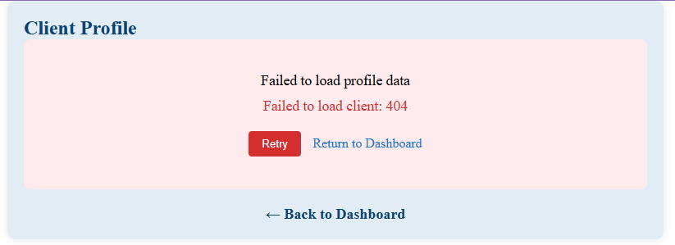
DEMO SCREENSHOTS
Profile View
API response Example

Slide 11
CONCLUSION & FUTURE WORK
System successfully supports healthcare client management
Can easily scale with backend integration
Future Enhancements:
Authentication and User Roles
Secure Database Storage
More detailed client health records

